Slide 1
Reproducibility and Best Practices
© Dr. Umberto Michelucci - umberto.michelucci@toelt.ai

Slide 2
Machine Learning Pipelines and Approaches
© Dr. Umberto Michelucci - umberto.michelucci@toelt.ai

Slide 3
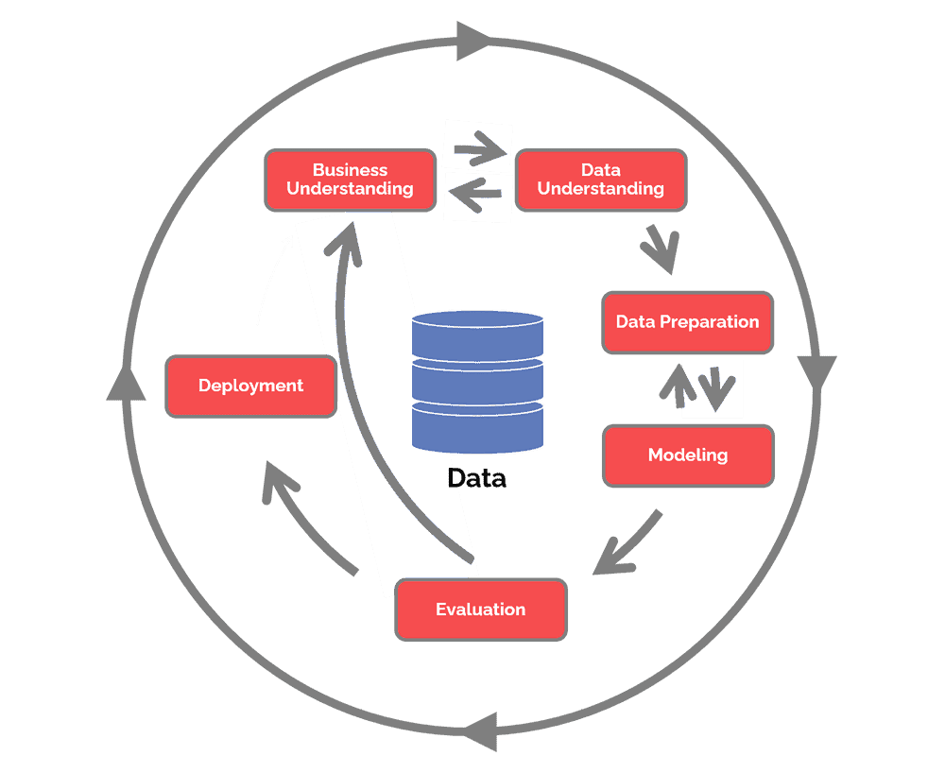
CRISP-DM – Phasen (CRoss Industry Standard Process for Data Mining)
© Dr. Umberto Michelucci - umberto.michelucci@toelt.ai
Source: https://www.datascience-pm.com/crisp-dm-2/ (last accessed 23rd Feb. 2023)

Slide 4
Files and phases
Business understanding: a short document (word, markdown, jupyter notebook) explaining in detail what is the problem you are trying to solve)
Data understanding: at least one (maybe multiple) jupyter notebooks in which you analyse the data you plan to use. Document it well and use visualisation as much as you can.
Data preparation: at least one jupyter notebook where you perform the data cleaning and preparation. At the end save the prepared dataset to use in the next phase.
Modeling: at least one juypter notebook (or script) where you train your model. Save the results and the models that you want to evaluate here (sometime training models takes many hours, you do not want to repeat that many times).
Evaluation: at least one jupyter notebook where you document the evaluation phase.
Deployment: often multiple documents, scripts, etc. depending on the situation and the project.
© Dr. Umberto Michelucci - umberto.michelucci@toelt.ai

Slide 5

Files / Phases
DESCRIPTION OF DATA
PROBLEM
DESCRIPTION
RAW DATA
PROCESSED DATA
MODEL / MODEL RESULTS
Jupyter Notebooks
Jupyter Notebook
© Dr. Umberto Michelucci - umberto.michelucci@toelt.ai
Jupyter Notebook
Word Doc,
Markdown, etc.
EVALUATION RESULTS
Physical object that must be
Saved somewhere

Slide 6
Example: data folder structure
data
raw
cleaned
processed
© Dr. Umberto Michelucci - umberto.michelucci@toelt.ai
Unmodified data with references, description, etc.
Cleaned data. For example without records with missing data.
The final dataset that will be used. Maybe multiple datasets merged, for example.

Slide 7
Open Science and Reproducibility
© Dr. Umberto Michelucci - umberto.michelucci@toelt.ai

Slide 8
Reproducibility and Replicability (two opposite definitions)
“Reproducibility” refers to instances in which the original researcher's data and computer codes are used to regenerate the results, while “replicability” refers to instances in which a researcher collects new data to arrive at the same scientific findings as a previous study.
“Replicability” refers to independent researchers arriving at the same results using their own data and methods, while “reproducibility” refers to a different team arriving at the same results using the original author's artifacts.
© Dr. Umberto Michelucci - umberto.michelucci@toelt.ai
National Academies of Sciences, Engineering, and Medicine. "Reproducibility and replicability in science." (2019).

Slide 9
Open Science and Reproducibility Promoting Open Science helps researchers
to more easily and reliably build on previous work through Open Access publications and openly available data
to accelerate discovery through less repetition of inaccessible work and of data already produced for other projects
to increase and maintain the trustworthiness of scientific results which can be verified and replicated
© Dr. Umberto Michelucci - umberto.michelucci@toelt.ai
https://openscience-summerschool.ch/assets/downloads/lectures/osss-2022-presentation-furrer.pdf

Slide 10
Promoting Reproducibility helps researchers
to efficiently benefit from openly available data
to accelerate discovery even more through “easily” reproducible projects with shared software and scientific workflows
to verify and replicate scientific results
© Dr. Umberto Michelucci - umberto.michelucci@toelt.ai
https://openscience-summerschool.ch/assets/downloads/lectures/osss-2022-presentation-furrer.pdf

Slide 11
Your task as (Data) Scientists
One important task, as scientists, is to make sure that your work is reproducible. If is not, your work is scientifically useless.
In addition your work must be transparent. All the steps must be clear and understandable. Another researcher must be able to re-implement (or understand) everything you did (every single step) from scratch.
© Dr. Umberto Michelucci - umberto.michelucci@toelt.ai

Slide 12
Machine Learning Pipelines
© Dr. Umberto Michelucci - umberto.michelucci@toelt.ai

Slide 13
Machine learning pipeline (research components)
Data Preparation
Data must be loaded, prepared, cleaned, organised in a pandas or numpy array, etc.
Modelling
Various models should be trained with hyper-parameter tuning (for example using transfer leraning, etc.)
Model Validation
A fundamental step: models should be checked for generalisation and validated against the research questions.
Problem formulation
An exact and precise Research Question must be formulated.
© Dr. Umberto Michelucci - umberto.michelucci@toelt.ai

Slide 14
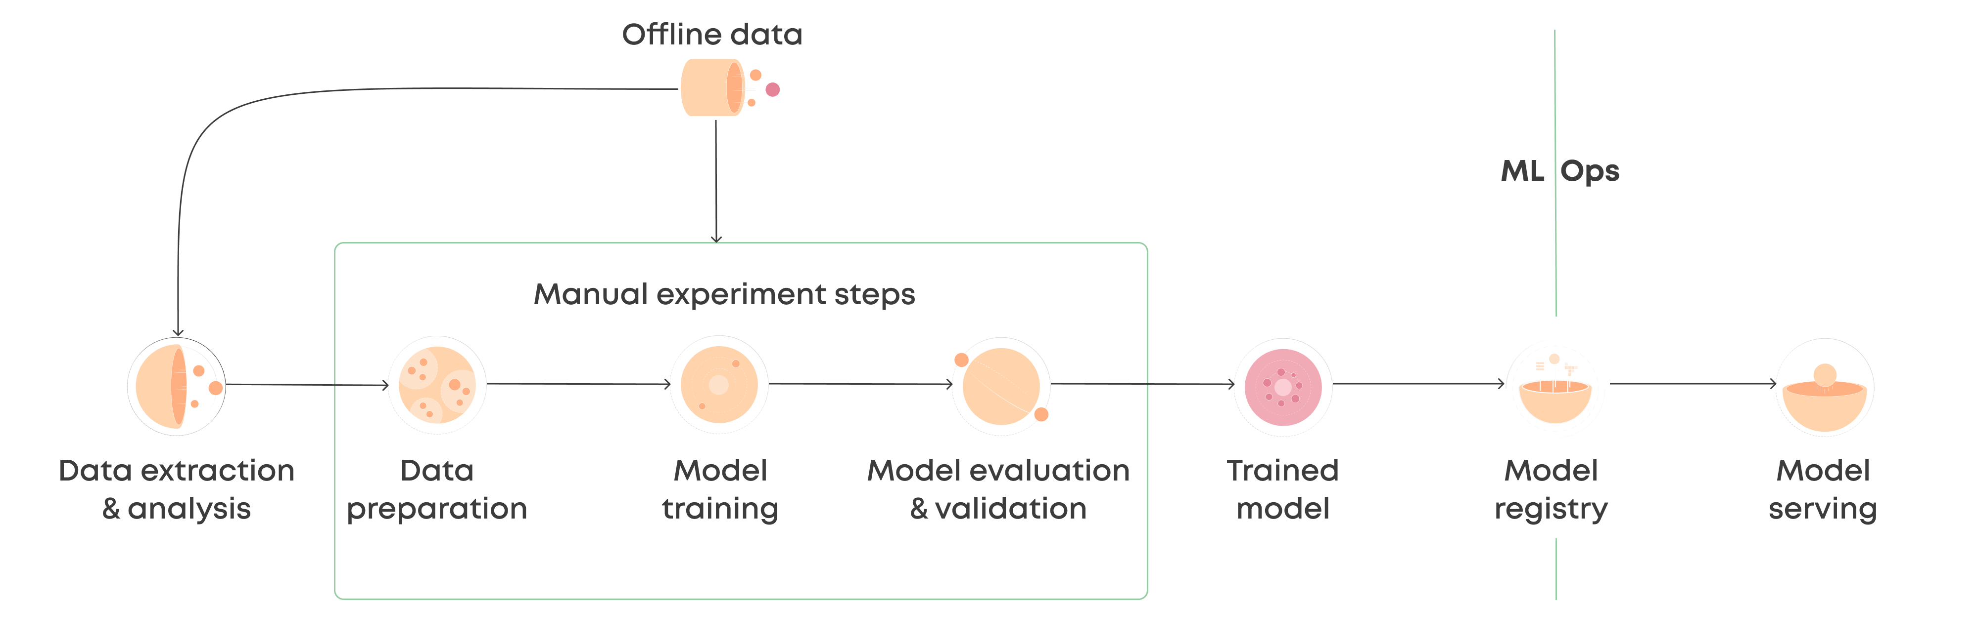
Machine learning pipeline
© Dr. Umberto Michelucci - umberto.michelucci@toelt.ai
Research Questions Formulation
Main part on which you will work in your Transfer Arbeit. Other parts can be included.
https://valohai.com/machine-learning-pipeline/

Slide 15
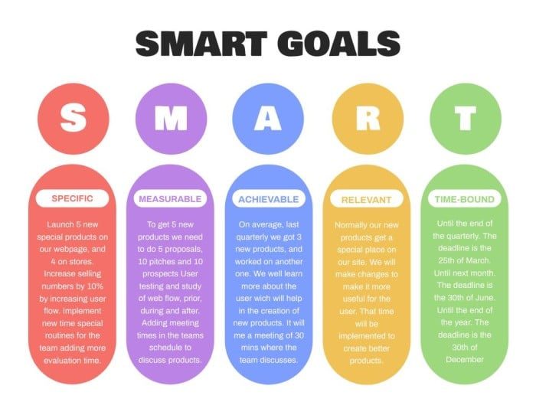
What should be in your project idea?
The following parts are important
One (or multiple) research questions.
Multiple concrete goals (formulated in SMART format)
Brief description of the data you plan to use (if possible with an overview of the features, origin, etc.)
The following parts are less relevant and can be superficial
Modelling part (which models, approaches, etc.). You will learn this material during the course.
Model Validation.
© Dr. Umberto Michelucci - umberto.michelucci@toelt.ai
Image Source: https://wepik.com/template/simple-smart-goals-formula-general-infographic-r-41737282

Slide 16
Research Questions and Hypothesis
An overview
© Dr. Umberto Michelucci - umberto.michelucci@toelt.ai

Slide 17
Research Questions and Hypothesis
© Dr. Umberto Michelucci - umberto.michelucci@toelt.ai

Slide 18
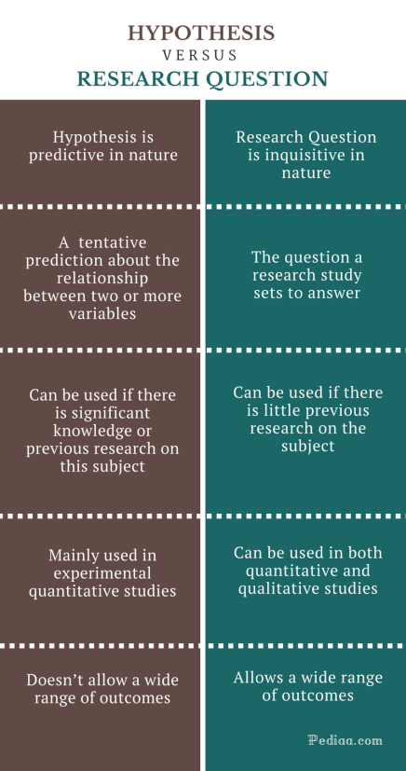
Difference between Hypothesis and Research Questions
© Dr. Umberto Michelucci - umberto.michelucci@toelt.ai
https://pediaa.com/difference-between-hypothesis-and-research-question/

Slide 19
Research Questions
Research questions are often used in qualitative research, which seek to answer open-ended questions. But they can also be used in quantitative studies. Research questions can be used instead of hypotheses when there is little previous research on the subject. Research questions allow the researcher to conduct more open-ended queries, and a wide range of results can be reported.
© Dr. Umberto Michelucci - umberto.michelucci@toelt.ai
https://pediaa.com/difference-between-hypothesis-and-research-question/

Slide 20
Hypothesis
A hypothesis is a prediction about the relationship between two or more variables. It can be described as an educated guess about what happens in an experiment. Researchers usually tend to use hypotheses when significant knowledge is already available on the subject. The hypothesis is based on this existing knowledge. After the hypothesis is developed, the researcher can develop data, analyze and use them to support or negate the hypothesis.
© Dr. Umberto Michelucci - umberto.michelucci@toelt.ai
https://pediaa.com/difference-between-hypothesis-and-research-question/

Slide 21
Examples of research questions
What are the side effects of social media addiction on youth?
What are the factors that negatively impact the mental health of US people?
How effective carbon emission control strategies are?
© Dr. Umberto Michelucci - umberto.michelucci@toelt.ai
https://thephdhub.com/10-significant-differences-between-research-question-vs-research-hypothesis/

Slide 22
Examples of Hypotheses
Global warming have increased the sea level by 1 cm in the past 10 years on average globally.
Number of cars existing in Zürich is decreased drastically after the COVID year.
© Dr. Umberto Michelucci - umberto.michelucci@toelt.ai
https://thephdhub.com/10-significant-differences-between-research-question-vs-research-hypothesis/

Slide 23
How to decide what experiments to do in machine learning?
RQs
Writing research questions highlight the context and the impact of the research work.
Hypothesis
Having hypothesis allows the design of precise experiments including information as what data is necessary, what modelling, etc.
Experiments
From the RQs and hypothesis you can design experiments to prove or disprove your hypothesis
© Dr. Umberto Michelucci - umberto.michelucci@toelt.ai

